Slide 1

Physician Visit Cost Analysis Across the U.S.

Slide 2
Problem Statement Addressing Healthcare Cost Transparency and Disparities in Physician Visits
Issue of Transparency: There is a persistent lack of transparency in healthcare costs.
Patient Cost Estimation: Patients frequently underestimate the costs associated with healthcare.
Regional and Specialty Disparities: Cost disparities vary significantly across different regions and specialties.
Financial Impact on Patients: These disparities lead to substantial financial burdens, particularly affecting those in lower-income brackets or residing in high-cost areas.
Objective of Analysis:
To examine the variations in Medicare and copay costs by specialty.
To identify strategies that could reduce financial strain and promote equitable access to healthcare services.

Slide 3

Dataset
Datasets extracted from Medicare.gov’s Physician office visit costs, including regional pricing for new office visits, established office visits by specialities
1
Quick stats:
3.5 million entries, 16 features.
2
Notable features:
Min, max and mode Medicare and Copay pricing for new and established patients (14) by zip codes
3

Slide 4
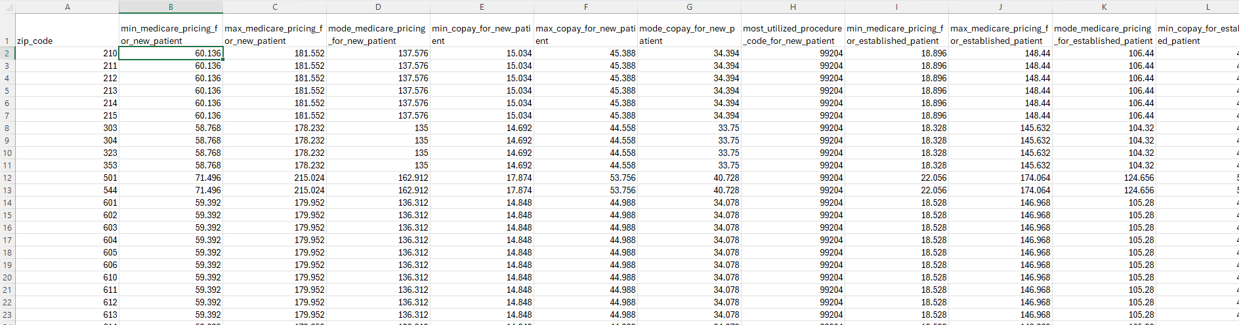
Raw Dataset
Data Source: https://data.cms.gov/provider-data/topics/physician-office-visit-costs

Slide 5
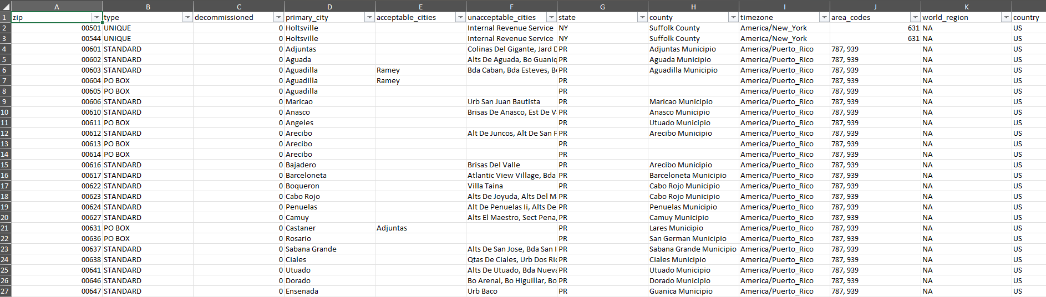
Zip Code Mapping
United States Zip Code Mapping Source: https://www.unitedstateszipcodes.org/zip-code-radius-map.php

Slide 6
Can the problem be solved from this dataset ?
Enhanced Cost Transparency and Geographic Cost Comparisons:
Patients throughout the US can gain a broader understanding of potential costs for various specialties based on their state/county/. This can help them make informed decisions when comparing Medicare pricing and copays for similar services across different areas within their area. This can be helpful for budgeting healthcare costs or exploring options in nearby locations.

Slide 7
What is the type of the problem solved ?
Informational/Planning
Help patients make informed decisions about where to seek care, estimate costs and plan for healthcare expenses.
Help providers identifying and comparing healthcare costs for new patients, both within specific regions and against state averages. By analyzing the average total costs and mode copay new patient data across different states, healthcare providers can identify regions with higher costs.

Slide 8
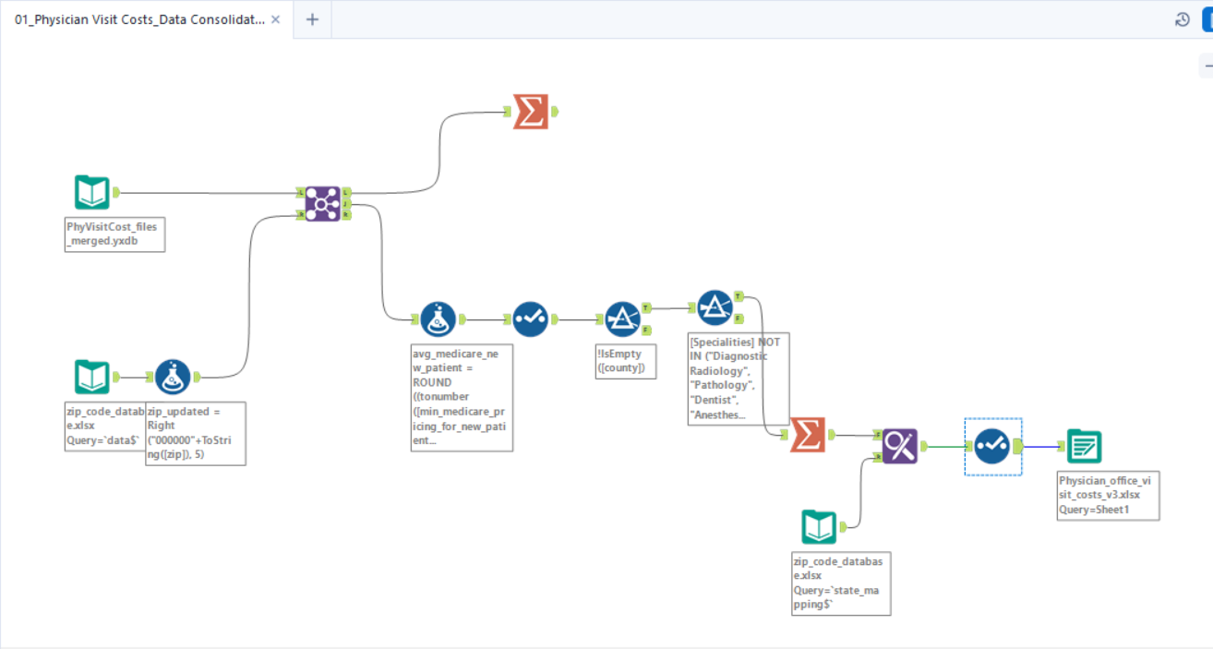
Data Blending with Alteryx

Slide 9

Visualizations

Slide 10
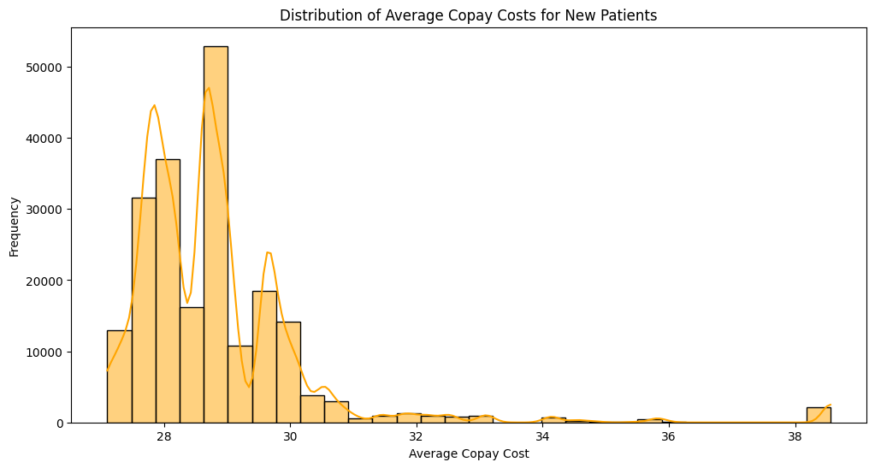
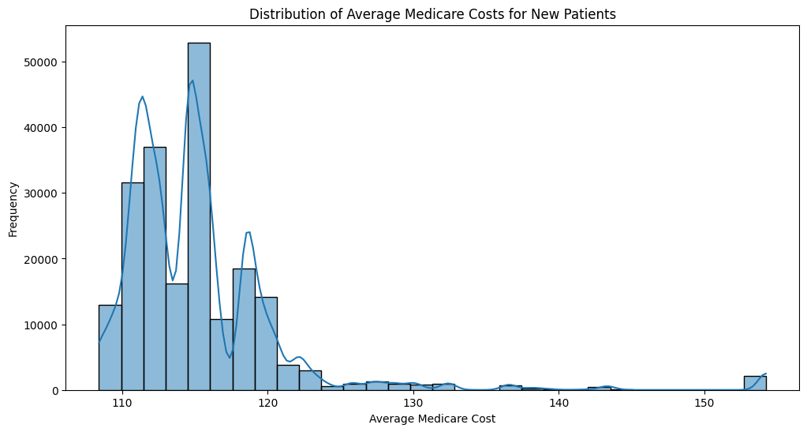
Healthcare Cost Distribution for New Patients - Medicare & Copay
Mostly the Medicare cost for new patients is around $120 and they pay $32 for their copay.
Patients in few areas have higher costs, up to $150 for Medicare and $38 for copay.

Slide 11
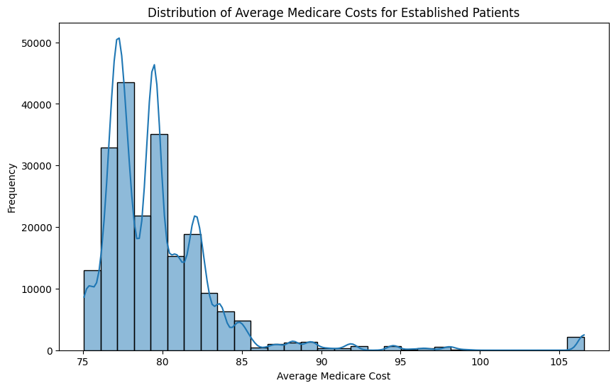
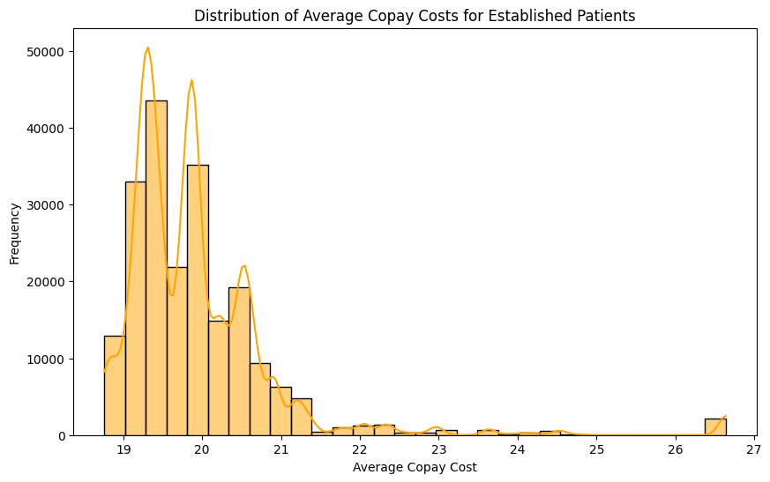
Healthcare Cost Distribution for Established Patients - Medicare & Copay
Established patients typically face Medicare costs around $80, while copay averages are near $21.
Multiple peaks in both charts suggest set cost levels that are common among patients.
Costs show a limited range, with Medicare costs mostly under $100 and copay costs under $27, indicating more consistent pricing for established patients compared to new ones.

Slide 12

Machine Learning

Slide 13
XGBoost Regressor
XGBoost stands for eXtreme Gradient Boosting, a scalable and accurate implementation of gradient boosting machines, renowned for its performance and speed.
It is used for regression tasks where the goal is to predict continuous out
XGBoost uses a more regularized model formalization to control over-fitting, which gives it better performance.

Slide 14

XGBoost Regressor
Key Advantages
High Performance: Often outperforms other machine learning algorithms in predictive accuracy.
Speed and Scalability: Utilizes parallel processing, tree pruning, and cross-validation, making it extremely fast and scalable.
Handling Missing Data: Has built-in routines to handle missing data, reducing the need for pre-processing.
Tree Pruning: Unlike traditional gradient boosting methods that grow trees greedily, XGBoost uses a depth-first approach and prunes trees using the ‘max_depth’ parameter, which results in more optimal and efficient trees.

Slide 15
XGBoost Regressor
Model Accuracy
R² Score: The model has an R² score of 0.934. This means that approximately 94% of the variability in the average Medicare payments for new patients can be explained by the model. This is a high score and indicates that the model is very effective in capturing the relationship between the features (State , county, and Specialties) and the target variable (avg_medicare_new_patient)
Model Error
MSE (Mean Squared Error): The MSE for the model is 2.392. MSE is a measure of the quality of an estimator, and it is always non-negative, and values closer to zero are better. A low MSE in our case suggests that the model's predictions are close to the actual data, meaning it performs well in predicting the average Medicare payments.

Slide 16
XGBoost Regressor
Model Accuracy
R² Score: The model has an R² score of 0.9397. This means that approximately 94% of the variability in the average Medicare payments for new patients can be explained by the model. This is a high score and indicates that the model is very effective in capturing the relationship between the features (State , county, and Specialties) and the target variable (avg_copay_new_patient)
Model Error
MSE (Mean Squared Error): The MSE for the model is 0.1367. MSE is a measure of the quality of an estimator, and it is always non-negative, and values closer to zero are better. A low MSE in our case suggests that the model's predictions are close to the actual data, meaning it performs well in predicting the average Medicare payments.

Slide 17
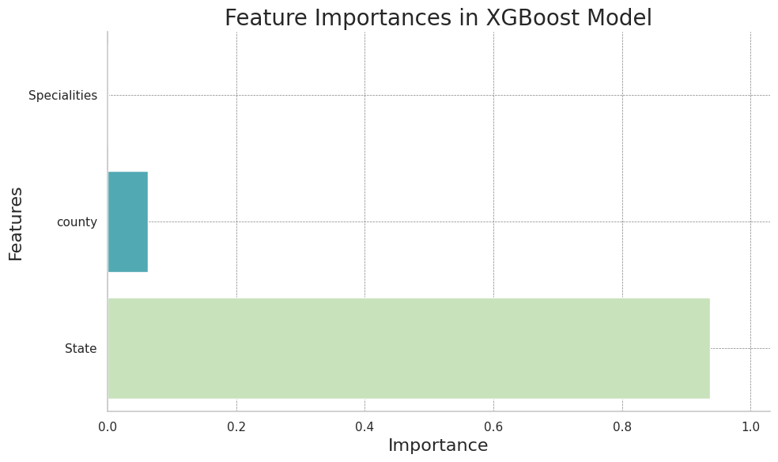
Feature Importance

Slide 18
Insights and Recommendations
High Healthcare Costs in Alaska: Alaska has expensive healthcare, mainly because it's far away from other places and has a lot of isolated areas where people live. Also, there aren't many doctors or hospitals, especially ones with special skills, and there isn't much competition among them.
How this Information Helps Doctors and Hospitals: This information can help doctors and hospitals decide where to work or expand. If they see that costs are high in some areas compared to the average for the whole state, they might see a chance to offer services that are cheaper but still good quality.
What Doctors and Hospitals Can Do: They can look at their prices and compare them to what's happening in the broader market. If they're in a high-cost area, they need to make sure their prices make sense for what they offer. But if their prices are lower than others in the area, they could either keep them low to attract more patients or maybe raise them a bit and still be cheaper than the rest.

Slide 19
References
Data Source: https://data.cms.gov/provider-data/topics/physician-office-visit-costs
United States Zip Code Mapping Source:
https://www.unitedstateszipcodes.org/zip-code-radius-map.php
https://bmchealthservres.biomedcentral.com/articles/10.1186/s12913-022-08711-x
https://healtheconomicsreview.biomedcentral.com/articles/10.1186/s13561-022-00409-4
https://www.healthsystemtracker.org/brief/price-transparency-and-variation-in-u-s-health-services/

